Slide 1

Enhancing Customer Engagement Through Supermarket Data Mining
In today's competitive retail landscape, supermarkets possess a goldmine of transaction data that remains largely untapped for strategic marketing purposes. This project aims to transform raw supermarket data and population data into actionable insights, discovering knowledge about U.S. states to help businesses and investors target areas based on sales potential, profit potential, and market diversity.

Slide 2
Introduction
Vision
Leverage advanced data mining techniques to transform this raw data into valuable insights that can guide targeted marketing and business expansion decisions
Mission
Analyze supermarket data combined with population data from various U.S. states.
Goal
Help businesses and investors make informed decisions on which states offer the best opportunities based on key metrics like sales, profit, and market diversity.
Strategy
Identify states with the highest sales potential and profitability by analyzing combined supermarket and population datasets.
Classify states based on their product diversity to determine the suitability for different retail models.
Provide insights that will help businesses make data-driven decisions regarding expansion, marketing, and investment opportunities.

Slide 3
Data Preprocessing and Initial Analysis
Merging Datasets
Per Capita Calculations
Initial Rankings
We created a new dataset by merging supermarket and population data. Numeric data was converted to ordinal categories for profitability and population size.
We computed total sales per capita and total profit per capita to normalize data and enable easier comparison between states.
Initial rankings based on sales and profit per capita showed Delaware, Rhode Island, and Washington as potentially prime locations for superstores.

Slide 4
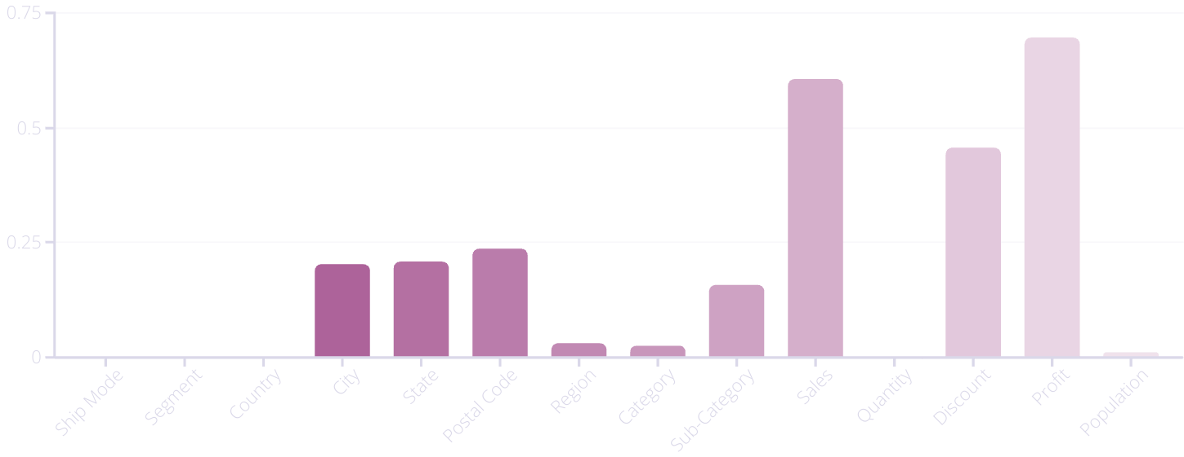
Information Gain Analysis
High Information Gain
Moderate Information Gain
Low Information Gain
Sales, discount, and profit variables showed the highest information gain, indicating strong correlation with profitability.
Sub-Category and location variables (City, State, Postal Code) offered moderate information gain, suggesting potential usefulness for prediction.
Many other categories showed minimal information gain, indicating limited usefulness for predicting profit.

Slide 5

Clustering Analysis
1
2
3
Data Standardization
Dimensionality Reduction
K-Means Clustering
Used StandardScaler to normalize sales and profit per capita data.
Applied Principal Component Analysis (PCA) to reduce data to a single dimension.
Implemented K-Means algorithm with K=3 to group states into distinct clusters.

Slide 6
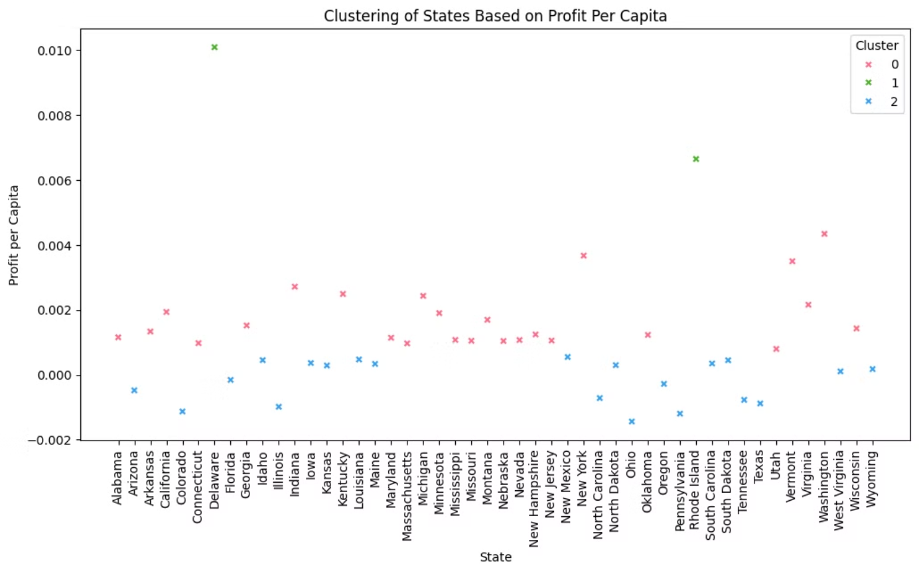
Delaware and Rhode Island were clustered as High profit potential

Slide 7
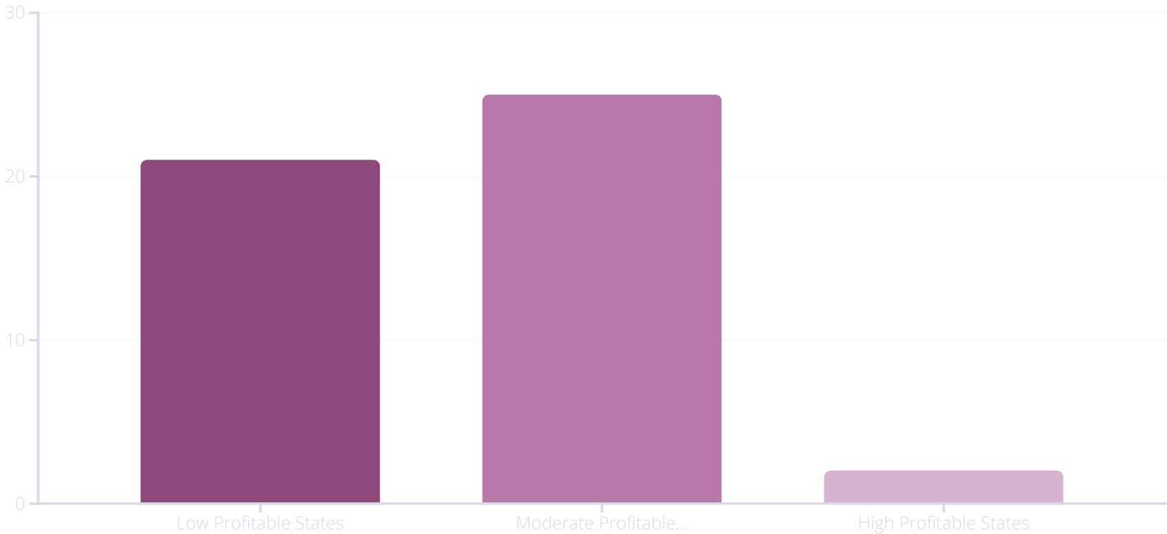

Slide 8
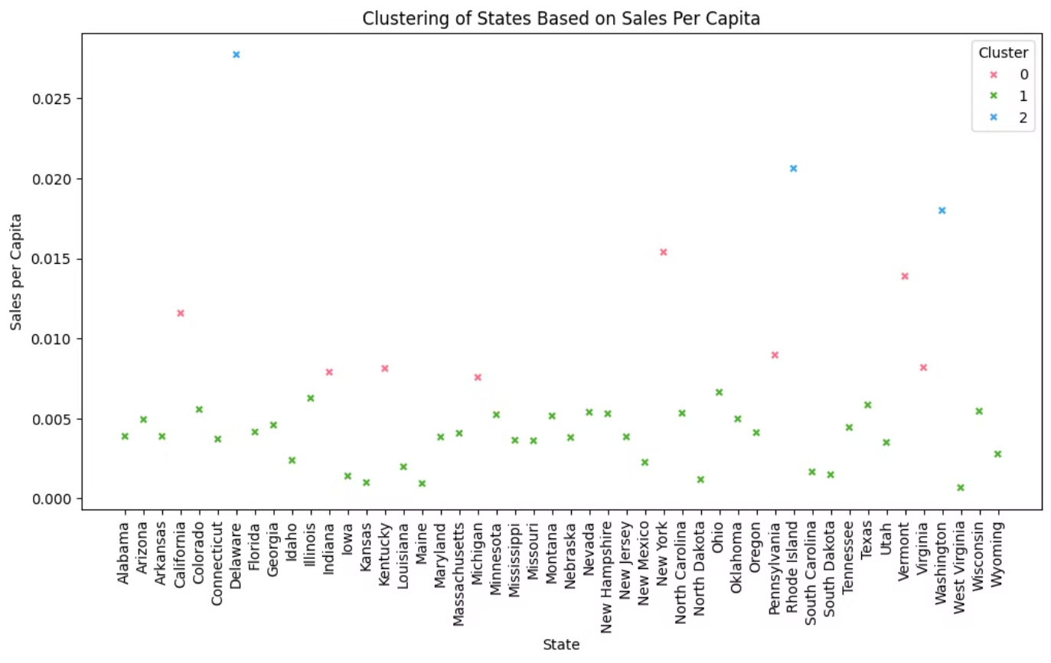
Delaware, Rhode Island and Washington were clustered as High sales potential

Slide 9
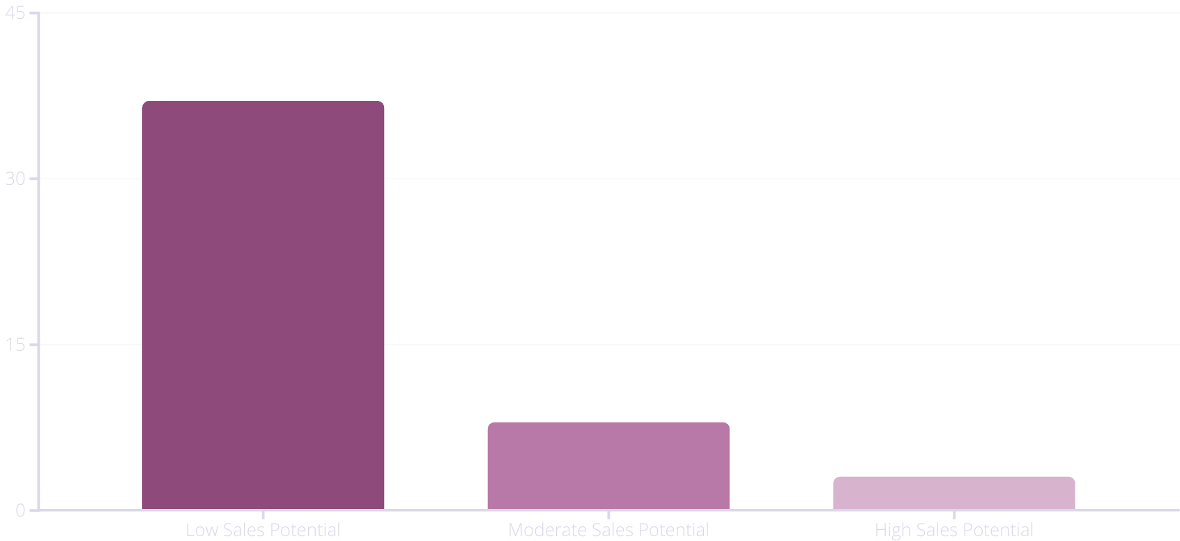

Slide 10



Classification of States
High Potential
1
Sales ratio > 0.01 or Profit ratio > 0.005
Moderate Potential
2
0.005 < Sales ratio ≤ 0.01 or 0.0025 < Profit ratio ≤ 0.005
Low Potential
3
Sales ratio ≤ 0.005 or Profit ratio ≤ 0.0025
States were classified into High, Moderate, or Low Sales Potential and Profit Potential categories based on these thresholds. This classification provides a clear framework for prioritizing states regarding business opportunities.

Slide 11
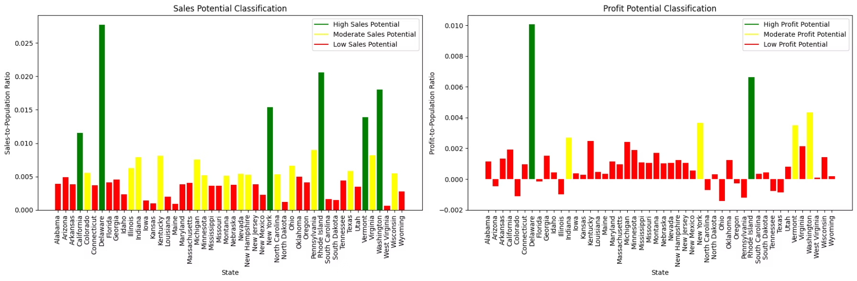
California, Delaware, New York, Rhode Island, Vermont, and Washington were classified as High sales potential
Delaware and Rhode Island were classified as High profit potential

Slide 12
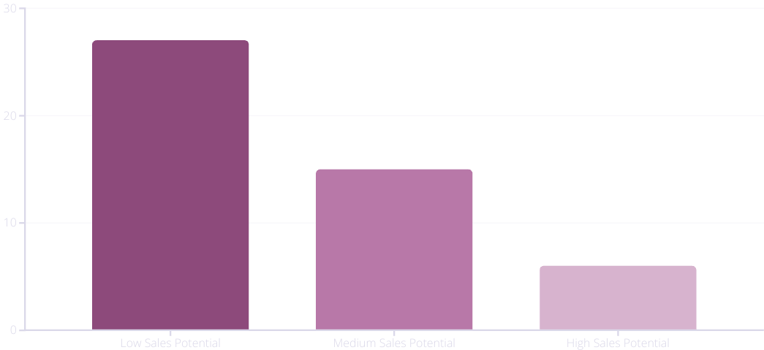
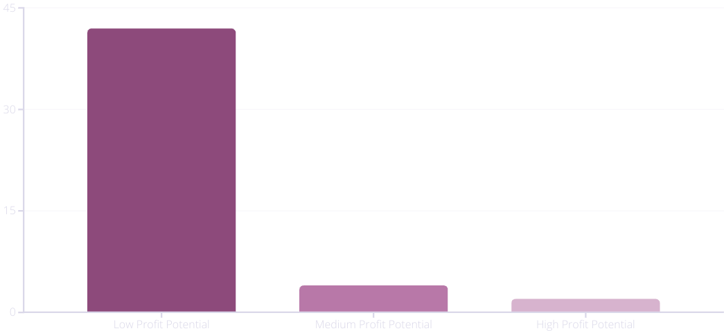

Slide 13
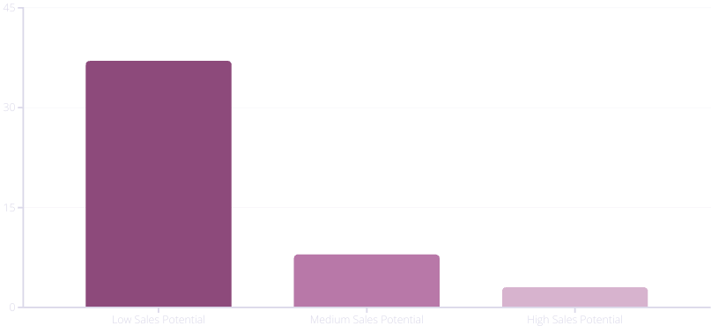
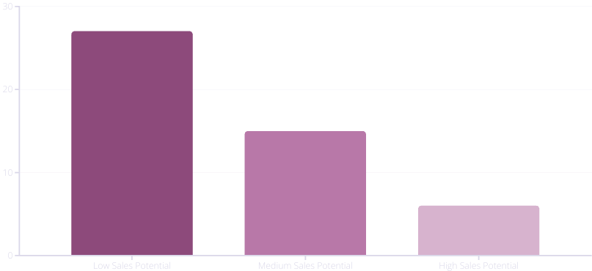
SALES POTENTIAL
CLUSTERING
CLASSIFICATION

Slide 14
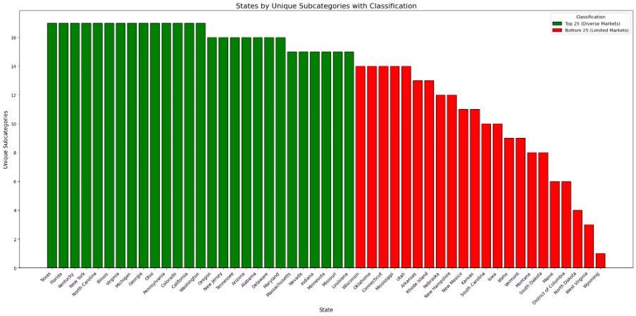
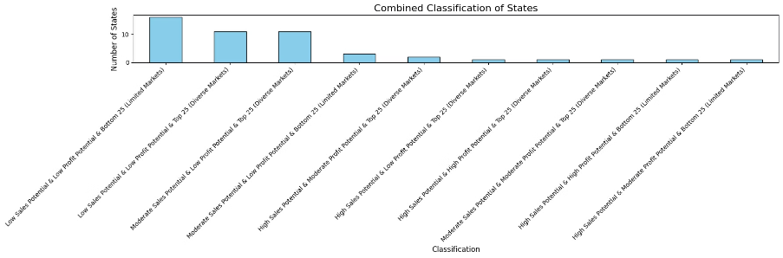
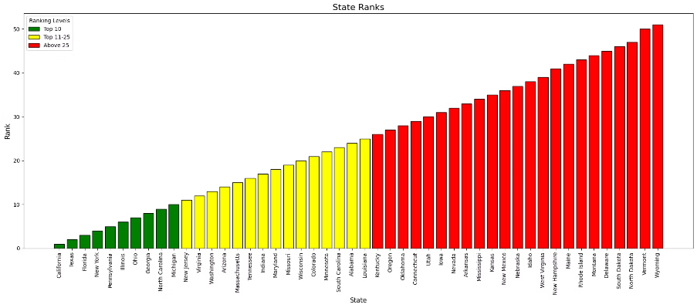
Sub-Category Diversity Analysis
We analyzed product diversity across states, grouping them by the number of unique sub-categories sold:
High Diversity: States like California have many sub-categories, indicating a robust retail environment.
Low Diversity: States like Wyoming have fewer sub-categories, suggesting niche or specialized markets.
This helps businesses determine the best retail strategy for each state - broad offerings or focused specialization.

Slide 15

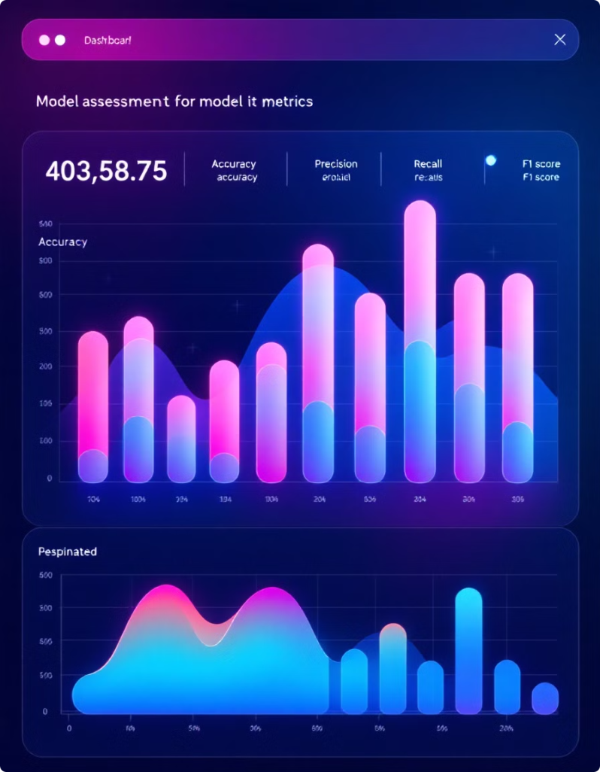
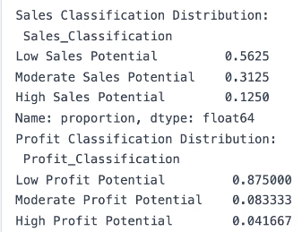
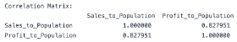
Model Assessment
Distribution
Correlation
56.25% of states had low sales potential, while 87.5% had low profit potential, indicating widespread challenges in profitability.
Strong positive correlation (0.827951) between sales-per-capita and profit-per-capita ratios, validating the interdependence of these metrics.
Data Quality
Silhouette Score
0% missing data, ensuring reliable and accurate model outcomes without risk of bias or distortion.
(0.5205434398474948,Profit PC 0.6231358103213682,Sales PC)

Slide 16




Key Findings and Insights
Top Performers
Widespread Challenges
Delaware, Rhode Island, and Washington consistently emerged as leaders in both sales and profit potential.
87.5% of states showed low profit potential, indicating significant difficulties in converting sales to profits.
Diverse Strategies
No direct relationship between item diversity and profitability, suggesting varied business strategies can be successful.

Slide 17




Conclusion and Next Steps
Actionable Insights
The analysis provides a detailed framework for identifying high-potential markets using clear thresholds and advanced data mining techniques.
Strategic Decision-Making
Businesses can use these insights to prioritize states for marketing, investment, and resource allocation.
Further Research
Explore additional factors influencing profitability and conduct more granular analysis at city or county levels.

Slide 18
THANK YOU!

